Slide 1

MACHINE LEARNING
Overfitting

Slide 2

Introduction
Cause of Overfitting
Solutions
CONTENT

Slide 3

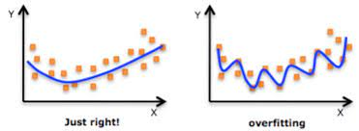
Introduction
There is an un-detouring issue in supervised machine learning when the model does not generalize correctly from observed data to unseen data. That is called overfitting, a scenario when a model performs perfectly on a training set but fits poorly on a testing set.

Slide 4

Cause overfitting
The data requirement for training a machine learning model is usually large but we usually use small datasets.
a dataset contains too much noise.
A model is too complex
An unbalanced data
Epoches
High variance and low bias.

Slide 5
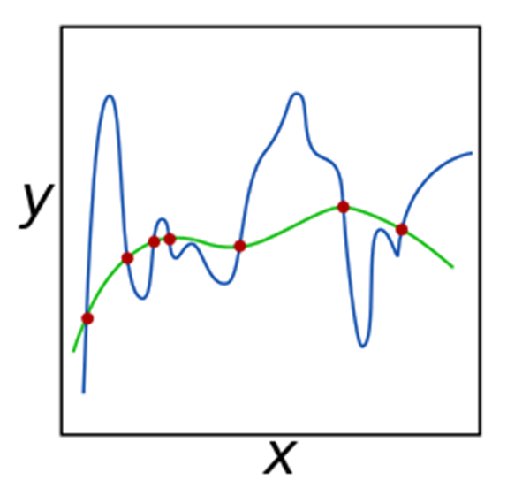


Solution
Regularization
Select only the useful features and remove the useless
Minimize the weights
lost_regularizor(ω; X, y) = lost(ω; X, y) + alpha*Ω(ω)
"gradient descent" :
w[k+1] = w[k] * (1 - lambda/m) - alpha/m * sum((p(x[i]) - y[i]) * x[i]) for i in range(1, m)

Slide 6
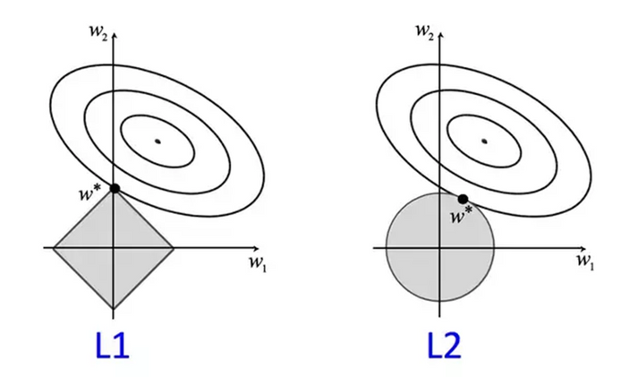
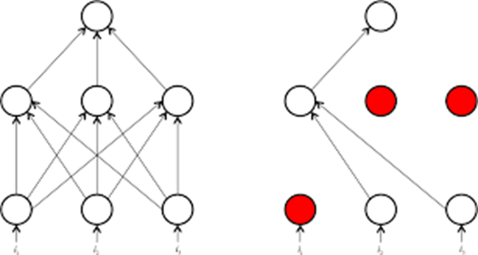
Solution
Regularization
1. L1 Regularization - Lasso Regression.
Ω(ω) = sum(|w[i]|) for i in range (1, m)
2. L2 Regularization - L2 Regularization
Ω(ω) = square_root(sum(w[i]^2)) for i in range(1, m)
3. Dropout

Slide 7

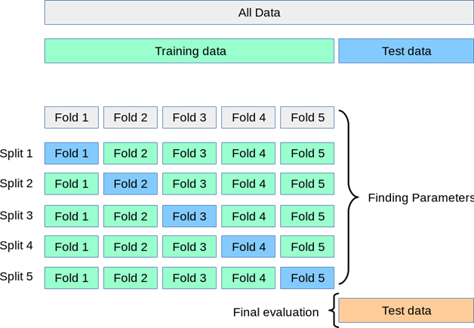
SOLUTION
2. Cross-validation
In this method, the dataset is divided into smaller folds, where the model is trained on the majority of the dataset and evaluated on the remaining data

Slide 8
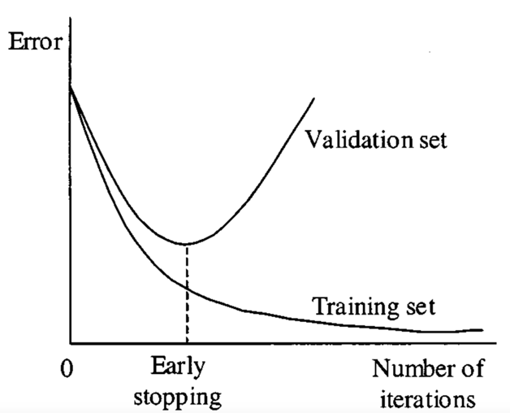
SOLUTION
3. Early Stopping
Stopping the training process before the model reaches its optimal accuracy on the training data.
Noise reduction:
Purning
Pre-Purning
Post Pruning

Slide 9
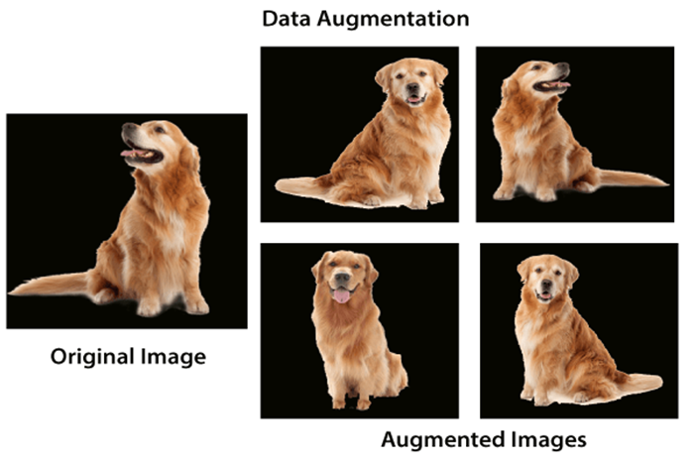
SOLUTION
4. Augment the training data
In some cases, overfitting is caused by a lack of training data. Datasets play a crucial role in affecting the performance of a model.

Slide 10

THANK YOU FOR YOUR LISTENING

